Slide 1
Inventory Management Types of inventory, inventory carrying costs, economic order quantity model (EOQ).
BUSI 104 – Operations Management
Professor Ed Arnheiter

Slide 2
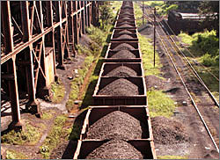
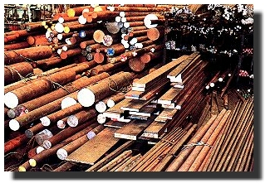
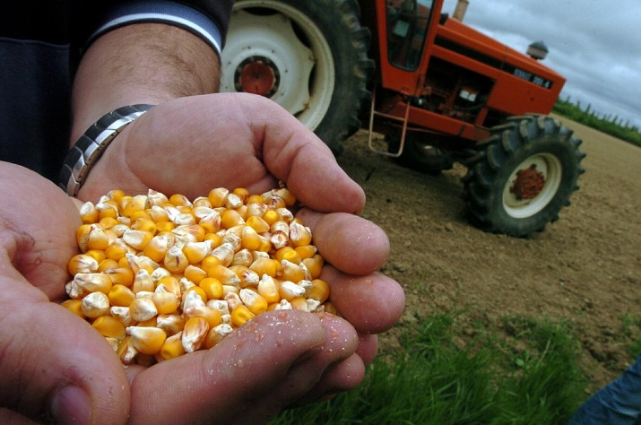
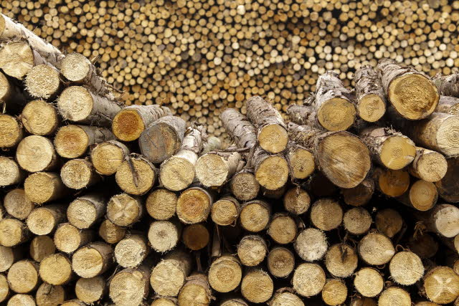
Types of Inventories:
Raw Materials
Unprocessed or Semi-Processed
Iron Ore
Bar Stock
Corn
Timber

Slide 3
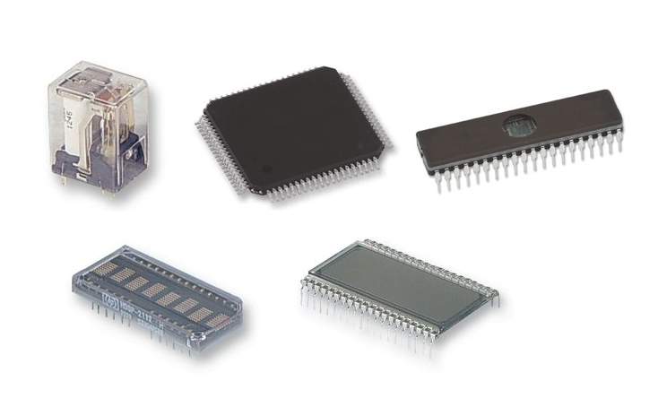
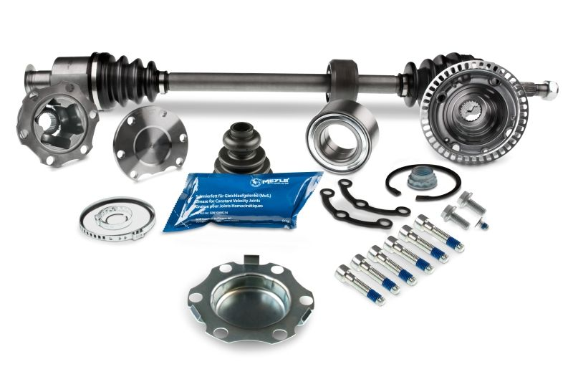
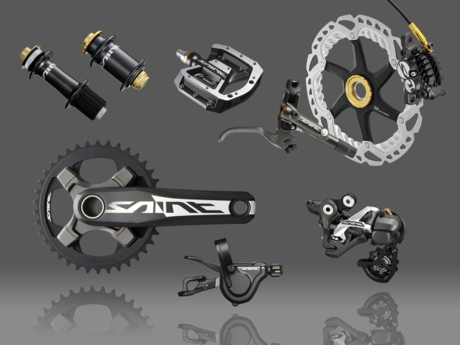
Types of Inventories:
Components
(of course, YOUR components might be MY finished goods)
Computer components
Car Components
Bicycle Components

Slide 4

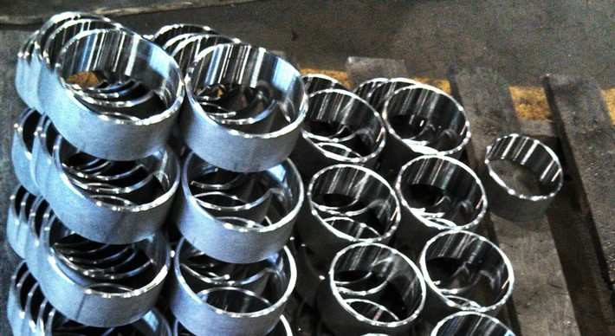
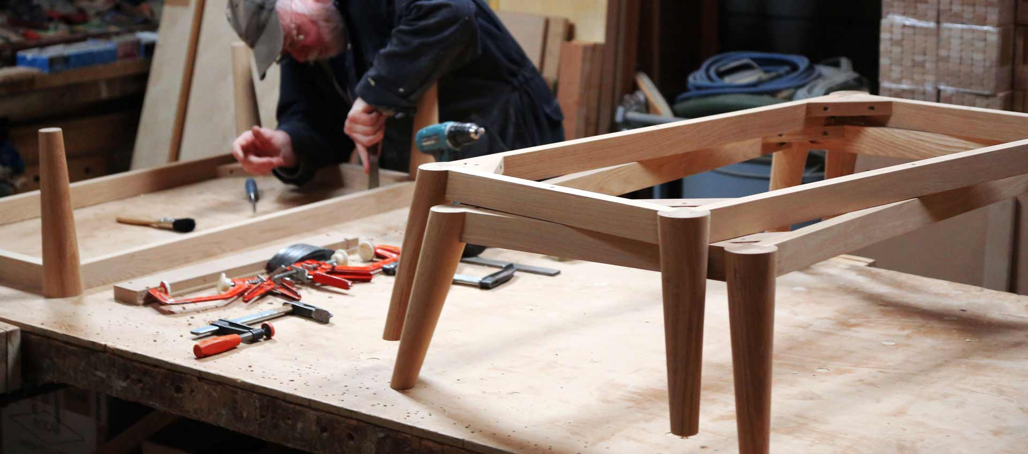
Types of Inventories:
Work-in-Process (WIP)
In the process of being transformed and therefore partly complete

Slide 5

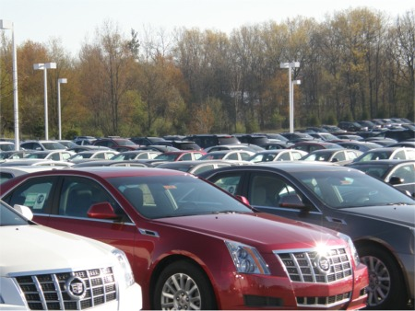
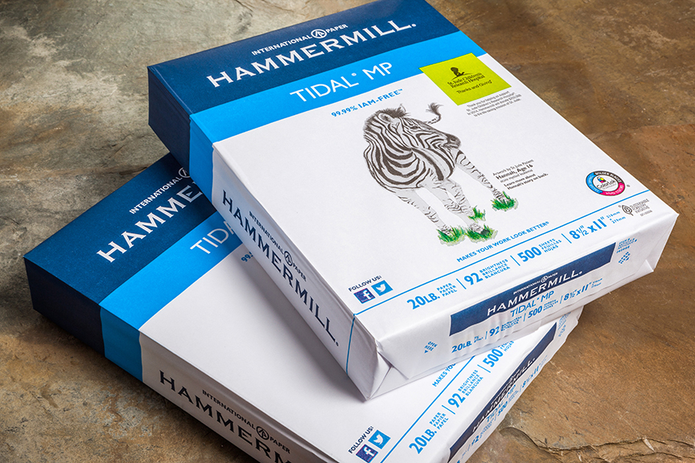
Types of Inventories:
Finished Goods

Slide 6
Inventory Holding Cost (H) Also known as Carrying Cost
Inventory carrying cost is an aggregated interest rate comprised of many components, including:
Cost of storage space (rent, depreciation, power, heat, cooling, taxes, insurance, etc.)
Breakage, spoilage, pilferage, deterioration and obsolescence.
Record keeping
Material handling equipment
Cost of capital. Opportunity cost of alternative investments.

Slide 7
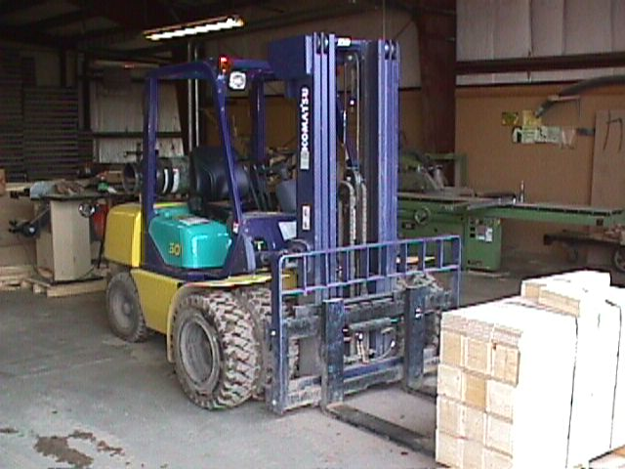
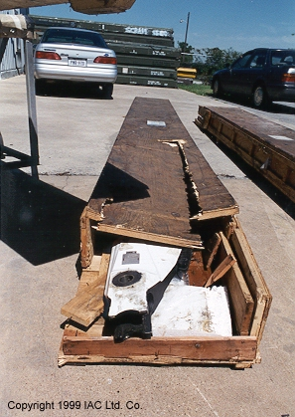
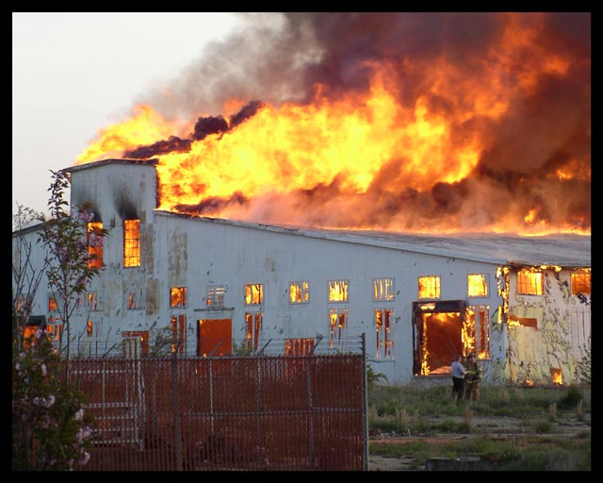

Example: Inventory Holding Cost
Cost of Capital = 5.0%
Taxes = 1.5%
Insurance = 1.0%
Obsolescence, breakage, etc. = 1.0%
Storage = 2.5%
Total Interest Charge = 11%

Slide 8
Inventory Holding Cost Example - Continued
Let: i = interest rate per time period
c = cost to buy or produce one unit of the inventory item (not the projected sales price)
If c = $1000, and i = 11% annually, then every unit held in inventory costs the company:
H = ic = ($1000)(0.11) = $110/year
Or
H = ic = ($1000)(0.11/12) = $9.17/month

Slide 9
Typical Values for Inventory Carrying Cost Components
Element | Ranges
Cost of Capital | 5 – 40%
Taxes | 0.5 – 2%
Insurance | 0 – 2%
Obsolescence | 0.5 – 2%
Storage | 0 – 4%
Total | 6 – 50%

Slide 10
Economic Order Quantity (EOQ)
Describes tradeoff between fixed order costs and holding costs.
Initial Assumptions:
Parts ordered from outside supplier
Demand known and constant
Shortages not permitted
No order lead time (instantaneous replenishment)
Costs include setup cost (S), proportional order cost (c) and holding cost (H).

Slide 11
Basic EOQ Model
Units on-hand
(Inventory)
Slope = Demand Rate (D)
Q
Cycle
length
Time
Symbol Q* will be used to represent EOQ.

Slide 12
Total Cost Expression for EOQ
Total Cost (TC) = Dc + [(D/Q)S] + [(Q/2)H]
Purchase
Cost
Annual ordering or Setup Cost
Annual Holding Cost
Ordering Costs
Average inventory level during one order cycle is Q/2 and since all cycles are identical, average inventory level over many cycles is Q/2.

Slide 13
Derivation of the EOQ Model
First derivative of total cost (TC) expression:
Solving for Q:

Slide 14
Lead Time In EOQ Model
Demand = {Reorder Point}/{Lead time}
Inventory
Slope = Demand Rate
Q*
Reorder point R
L

Slide 15
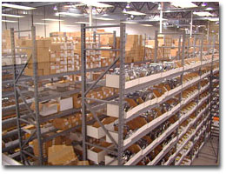
Lead Time in EOQ Model
Reorder point (R) - On-hand inventory at instant order should be placed. For constant demand and lead time, no safety stock is needed.
d average daily demand
L_{d} lead time in days
Could also use R = DL_{y}, where D is annual demand and L_{y} is lead time in years.

Slide 16
EOQ Example
A manufacturer of furniture produces metal desks at a rate of 400 per month. Each desk requires 60 fasteners purchased from a supplier. The supplier charges the furniture company $0.02 for each fastener. Fixed delivery charges and costs of receiving and storing shipments of fasteners amounts to about $120 per shipment, independent of the size of the shipment. The company uses an annual holding cost equal to 8% of the fasteners value.

Slide 17
EOQ Example – Continued
What is economic order quantity (EOQ)?
Approximately how many times per year would EOQ policy call for replenishment of fasteners?

Slide 18
EOQ Example – Continued
Month | Ending Inventory Level | Purchase Cost (@ $.02/item) | Holding Cost Charge
1
2
3
4
5
6
7
8
9
10
11
12
Total
Find the annual cost of setup and inventory holding for a typical year. Assume zero inventory carrying over from previous year (i.e., we must receive 1 shipment of size Q* at beginning of month 1).

Slide 19
Using the Total Cost Expression
If we use the expression for total cost (TC) shown earlier, we could find the average cost estimates over the long run.
For example:
The AVERAGE annual holding cost of the EOQ policy is [Q/2]H =.
The AVERAGE ordering or setup cost for the year would be (D/Q)S =

Slide 20
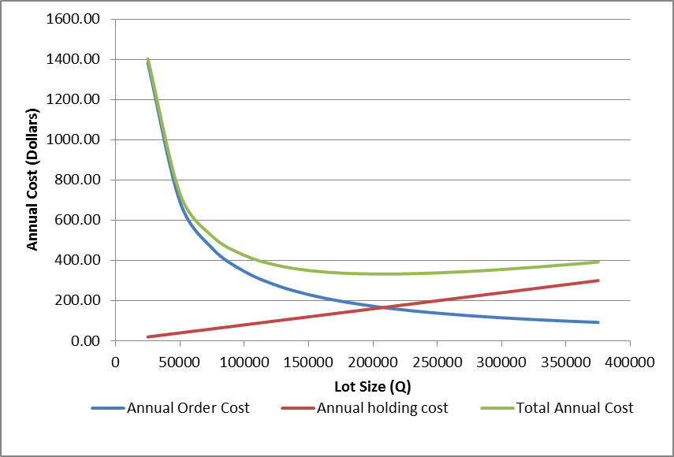
Desk Manufacturer Example Annual Holding, Ordering, and Total Costs Versus Lot Size (Q)

Slide 21
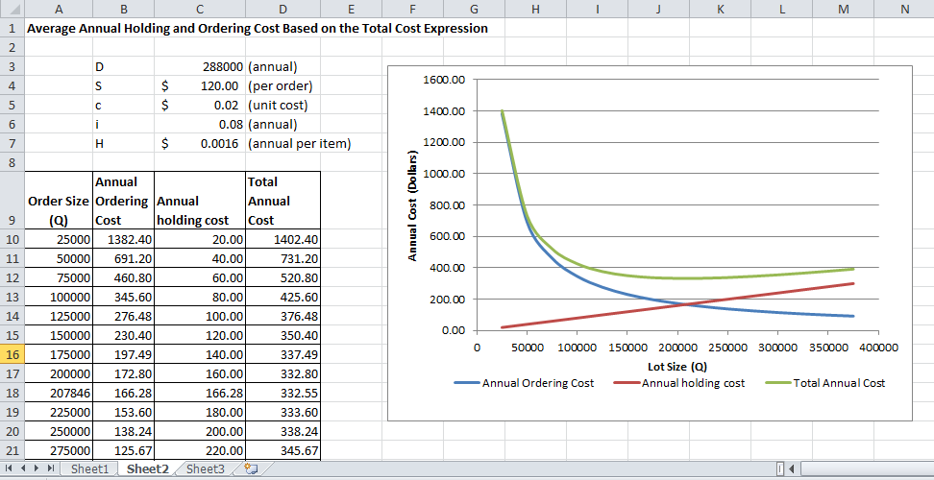
Annual Cost vs. Lot Size Excel Model

Slide 22
ABC Analysis Similar to Pareto Analysis
Calculate Annual Dollar Usage = Annual Usage Quantity x Value per unit
Sort SKUs by annual dollar usage, in declining order
Draw rough A-B and B-C class lines:
Class A: 20% of SKUs that represent 80% of dollar value
Class B: 30% of SKUs that represent 15% of dollar value
Class C: 50% of SKUs that represent 5% of dollar value

